Slide 1
IRIS intern update
8/4
Tse Liang

Slide 2
Target
Rep counting via segmentation. (ongoing)
Feature extraction from IMU signals. (success)
Activity classification using machine learning (Random Forest). (success)

Slide 3
Pipeline (training)
IMU Data Loading (get the data from the device)
Signal Preprocessing (Butterworth low-pass filter)
Repetition Segmentation (Peak Detection of 5 reps)
Feature Extraction(12 channels x 9 features each =108 features)
Activity Classification (Random Forest Classifier)
Repetition Validation (ongoing)

Slide 4
Rep Segmentation
The data we gathered were in 5 reps per data, so i want to break them up into 1 rep for better feature extraction.
from scipy.signal import find_peaks
Use find_peaks to detect peaks in filtered IMU signals.
Sets prominence threshold to 30% of the signal range
Requires minimum distance of 50 samples between peaks
Requires minimum width of 10 samples

Slide 5
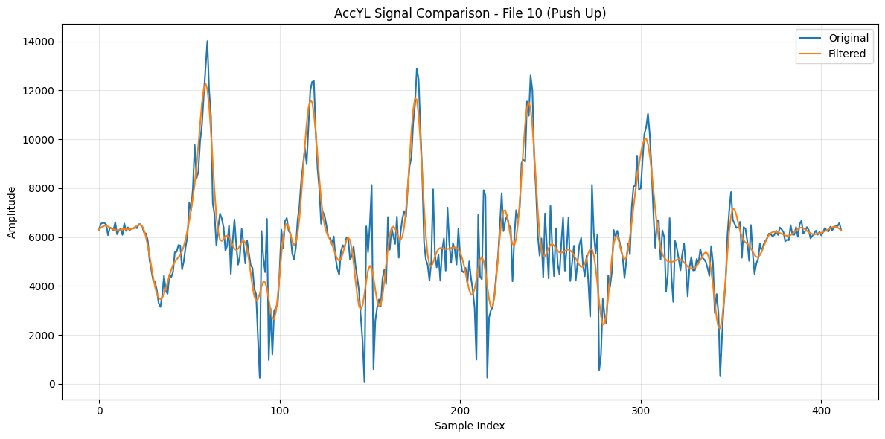
￼

Slide 6
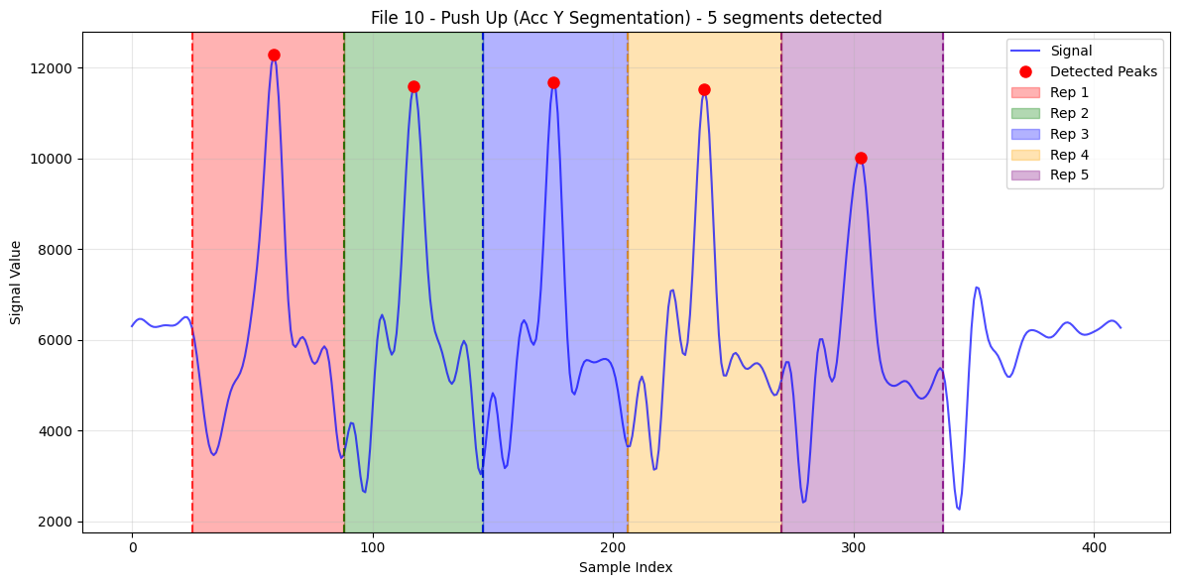

Slide 7
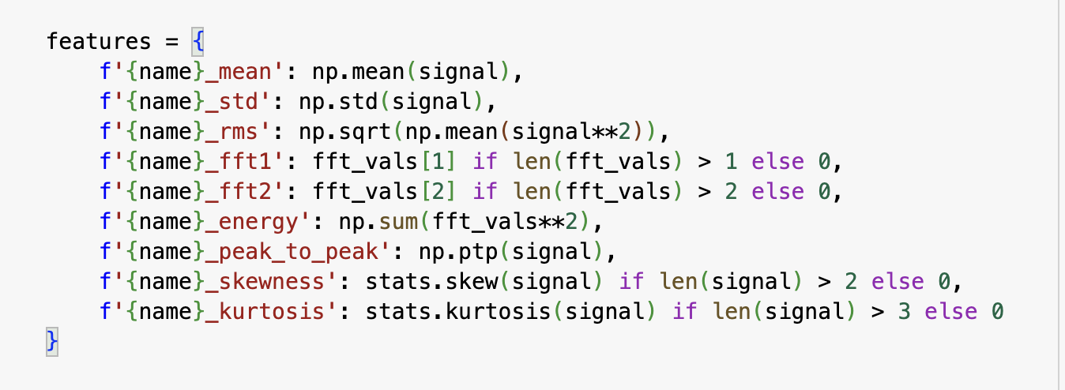
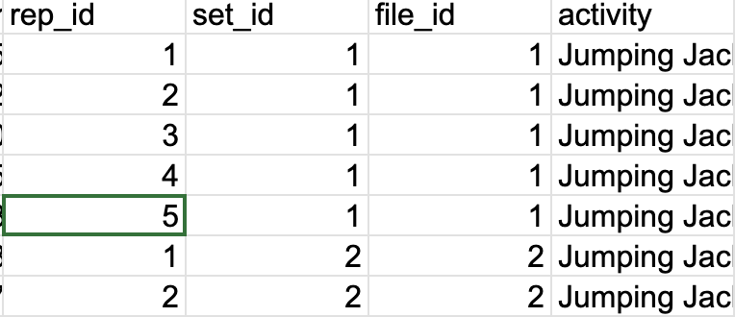
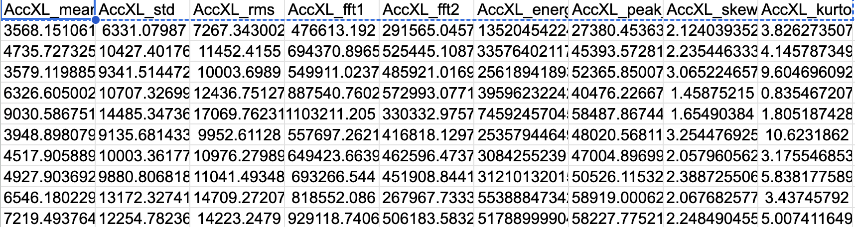
Feature Extraction

Slide 8
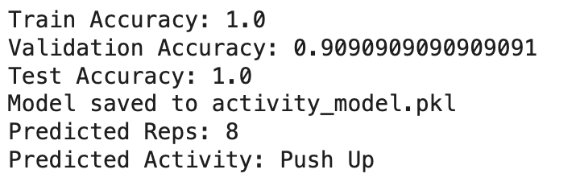
Activity Classification
Load CSV.
Split into train/val/test based on file IDs.( 70/15/15 )
Apply data augmentation to training data.
Train a Random Forest classifier.
Evaluate accuracy on train, val, and test sets.
Save trained model
Use RandomForestClassifier for structured, tabular feature data, better for small and noisy dataset.
X for 108 features
Y for labels ( push up, squat, jumping jack)

Slide 9
To be done and discussion
Counting of activity is still ongoing.
PCB will be sent out this week.
Might need to get more data, regarding the training of classifier.

Slide 10
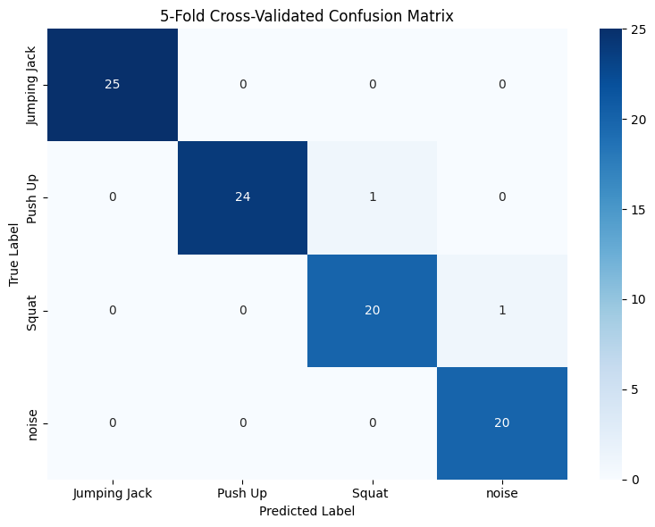
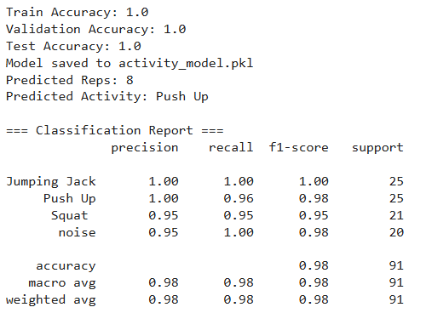
8/4
Added 20 walking data as noise

Slide 11
Thank you!

